Slide 1
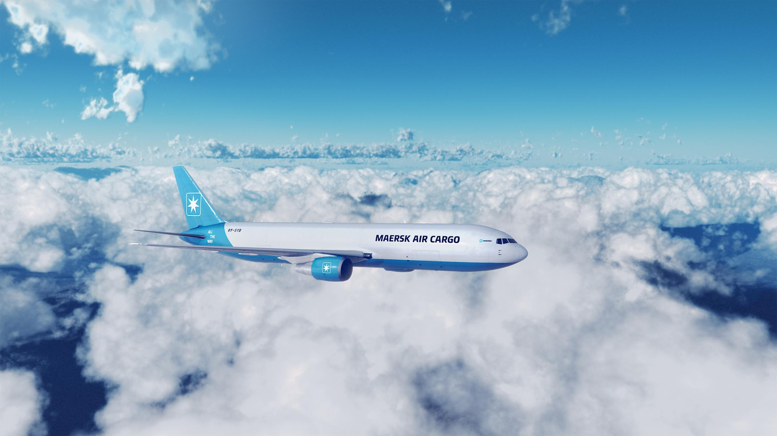
SMU DSA x Maersk
Case Competition 2023

Slide 2
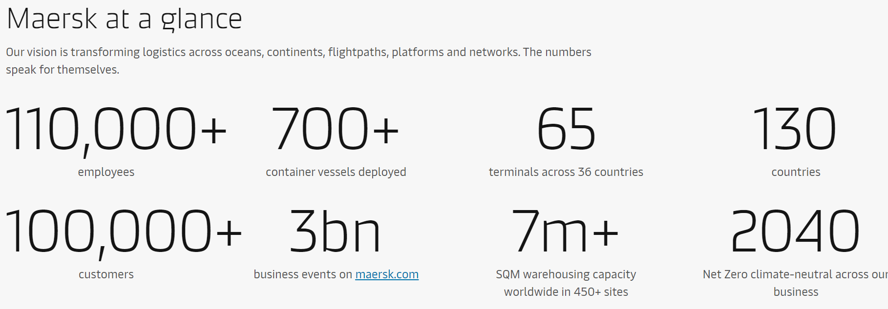
What is A.P. Moller-Maersk?
Headquartered in Copenhagen, Maersk is a global logistics company that has its background in shipping
As of 2023, the Group has > 110,000 employees globally and has a presence in at least 130 countries

Slide 3
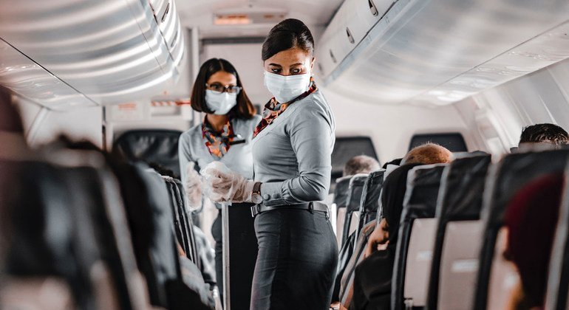

Problem Statement
In this case competition, we will be looking to improve the passenger service of a fictional airline that is looking to benchmark its service quality to that of leading global companies like Tesla, Apple and Amazon.
Taking your own experience as an airline passenger, analyze, scrutinize and review the given data set like a data scientist to draw out actionable insights that the airline can use to improve customer service.
The team that provides new, creative ways of fleshing out service improvement insights and how such insights can carry over to Maersk’s shipping business without compromising on model integrity and analytics principles will stand out.
We are looking for a balance between theory and application, with a focus on improving commercial figures and results.

Slide 4
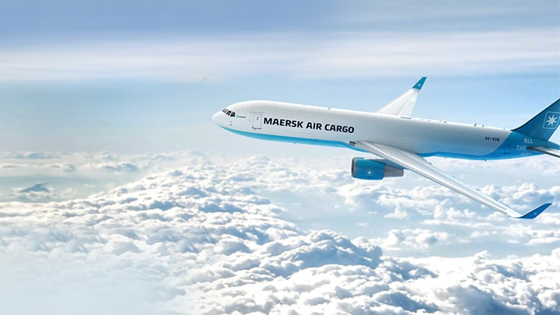
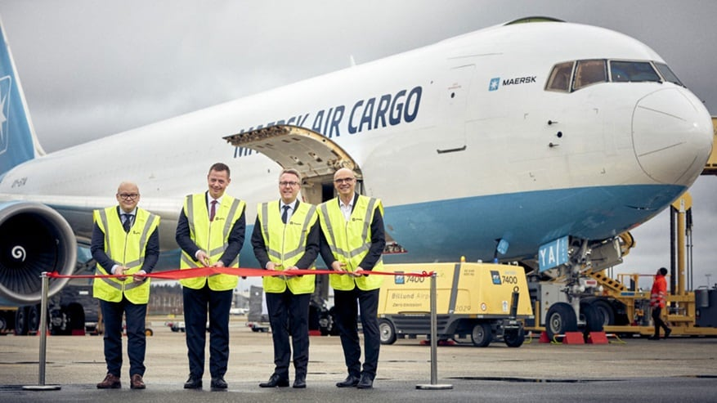
Problem Statement Link to Maersk
Whilst Maersk is known globally as a logistics player, customer service and quality improvements are integral part of the Maersk business model. Due to data confidentiality safeguards, we will be using the insights derived from a fictional airline to improve our air freight cargo business.
One of our key business lines is Maersk Air Freight. The service line provides air services designed to meet our customers’ logistics requirements. Customers can leverage our freighter network, partners, or in-house freight airline (Maersk Air Cargo) to fly goods quickly and efficiently across the globe.
You may refer to the following website for more information:
https://www.maersk.com/transportation-services/air-freight?exit=Air+Freight+EI

Slide 5
Overall Judging Criteria
Category | Scoring Weightage
Relevance to business question | 30%
Technical expertise and robustness in application of theory | 30%
Creativity in drawing out new/never-seen-before insights | 20%
Presentation flair/ability to wow judges | 10%
Ability to show value-add to Maersk business | 10%

Slide 6
Guiding Questions & Tips
What are the key drivers to a satisfied, neutral or dissatisfied customer?
What are the key drivers to a loyal or disloyal customer? Are they the same as the drivers to customer satisfaction?
Can we segment the base of customers and understand the key drivers affecting satisfaction for key segments?
What additional new insights does the Voice of Customer dataset (verbatim comments) provide?
Can we predict which customers will be satisfied; which customers will be loyal? You can choose to predict either one or both.
What are the similarities and differences between airline passenger and airfreight cargo flight handling when it comes to customer service? Is there a link between the treatment of human passengers and air cargo?
Imagine you are the CEO of the airline company, what measures will you put in place to improve customer service based on the descriptive and predictive insights you provided. Justify why/why not?
How does these measures enable a logistics and transportation company like Maersk improve its customer service programs? Be as creative as possible!
Tip: The most insightful model isn’t necessarily the most complicated model. Using highly advanced data science and machine learning techniques will only benefit you if it adds value to your findings!

Slide 7
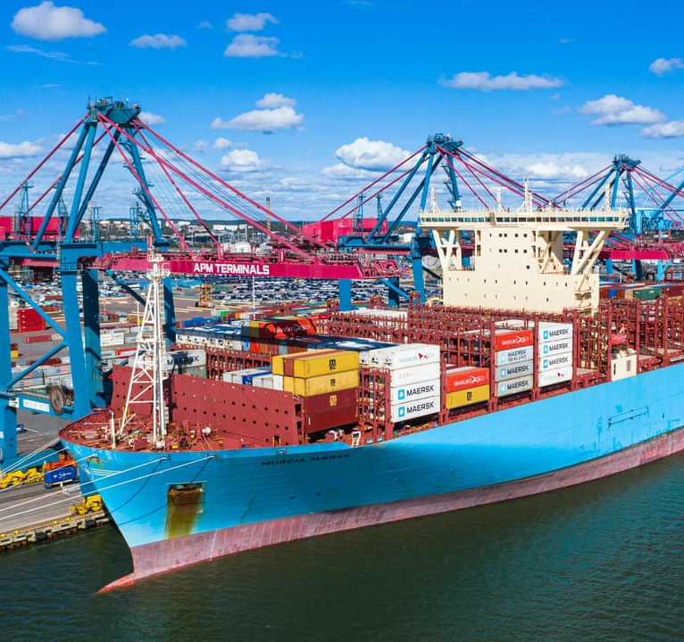
Competition Format

Slide 8
Overall Competition Timeline
Phase | Stage | Description | Timeline
1 | Case Distribution | Release of case materials to participants, including the case study, problem statement, and supporting datasets. | 19th July 2023
 | Preparation Period | Participants will analyze the case, conduct research, develop their solutions using the provided datasets, and prepare their model for submission. | 19th July 2023 – 1st August 2023
 | Model Submission | Deadline for participants to submit their model. Details and format of submission are on the following slide. | 1st August 2023 (12pm)
 | Model Judging | Evaluation of submitted models by Maersk judges. | 1st August 2023 – 7th August 2023 (Tentative)
2 | Finalists’ Selection & Preparation | Announcement of the shortlisted teams who will proceed to the final round. Shortlisted teams will be given some time to prepare for their final presentation. The final presentation will be based on your submitted model. You will present your model and any insights gained from it. More details will be given to the shortlisted teams. | 7th August 2023 – 11th August 2023 (Tentative)
 | Final Presentation & Judging | Finalist teams present their findings to a panel of judges comprising SMU professors and Maersk data science professionals. | 12th August 2023

Slide 9
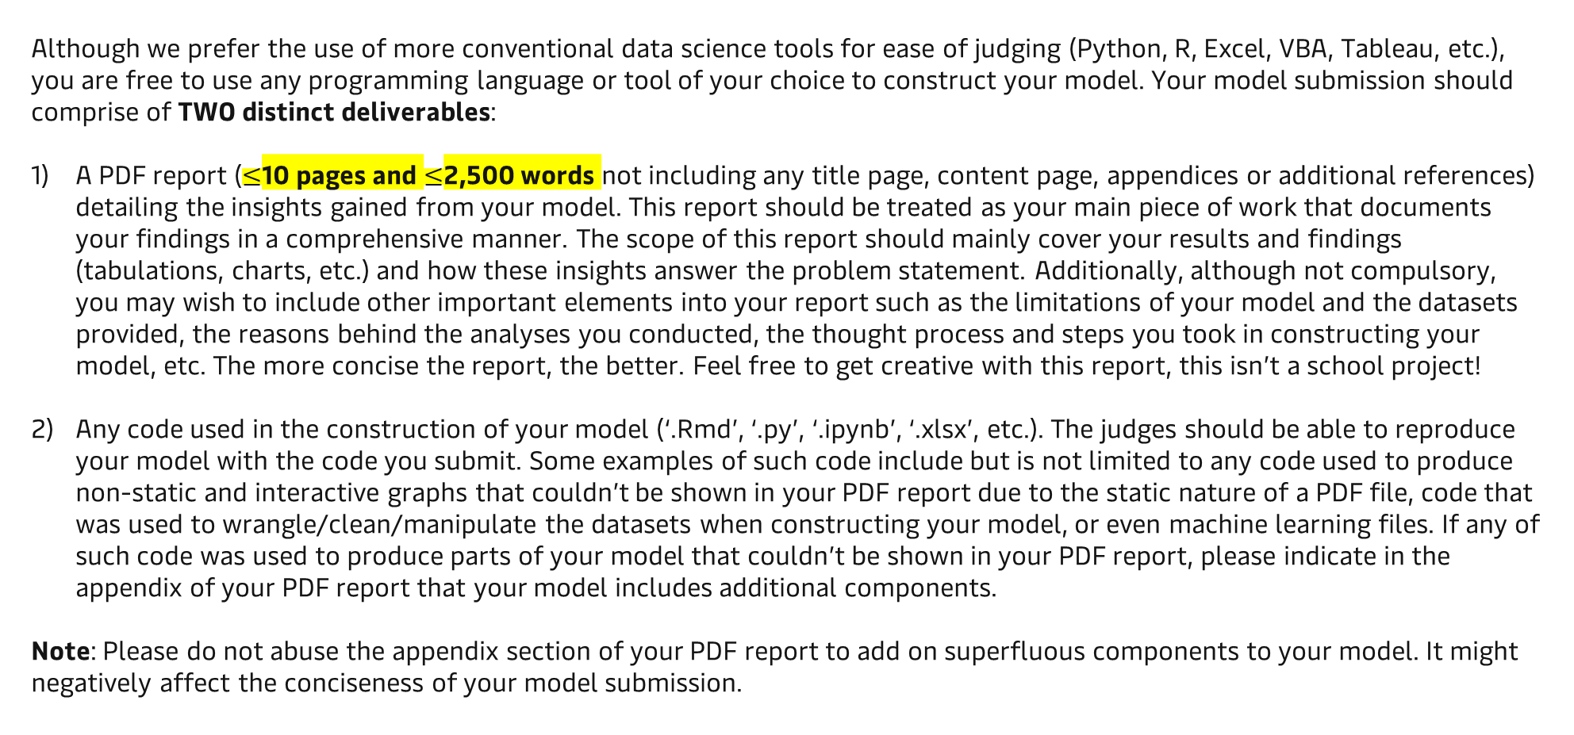
Submission Deliverables
Although we prefer the use of more conventional data science tools for ease of judging (Python, R, Excel, VBA, Tableau, etc.), you are free to use any programming language or tool of your choice to construct your model. Your model submission should comprise of TWO distinct deliverables:
A PDF report ($≤$10 pages and $≤$2,500 words not including any title page, content page, appendices or additional references) detailing the insights gained from your model. This report should be treated as your main piece of work that documents your findings in a comprehensive manner. The scope of this report should mainly cover your results and findings (tabulations, charts, etc.) and how these insights answer the problem statement. Additionally, although not compulsory, you may wish to include other important elements into your report such as the limitations of your model and the datasets provided, the reasons behind the analyses you conducted, the thought process and steps you took in constructing your model, etc. The more concise the report, the better. Feel free to get creative with this report, this isn’t a school project!
Any code used in the construction of your model (‘.Rmd’, ‘.py’, ‘.ipynb’, ‘.xlsx’, etc.). The judges should be able to reproduce your model with the code you submit. Some examples of such code include but is not limited to any code used to produce non-static and interactive graphs that couldn’t be shown in your PDF report due to the static nature of a PDF file, code that was used to wrangle/clean/manipulate the datasets when constructing your model, or even machine learning files. If any of such code was used to produce parts of your model that couldn’t be shown in your PDF report, please indicate in the appendix of your PDF report that your model includes additional components.
Note: Please do not abuse the appendix section of your PDF report to add on superfluous components to your model. It might negatively affect the conciseness of your model submission.

Slide 10
Submission Format
The deadline for the submission of your team’s model is 1st August 2023, 12pm. Your model files should be zipped into a folder named in the following format: ‘[Team Name]_Model_Submission.zip’ (e.g., ‘DSA Society_Model_Submission.zip’).
To submit your model, simply volunteer ONE representative from your team to send an email with the following details:
To: Jiahao Yee <jiahao.yee@lns.maersk.com>, DSA Society <dsasociety@sa.smu.edu.sg>, Martin CHENG <martincheng.2021@economics.smu.edu.sg>
Cc: Your Team Members
Subject: [Team Name] Case Competition 2023 Model Submission
Attachment: Your Team’s Model zip file
You may address the email to Maersk & DSA Society.
And you are done! The results for the 1st phase of the competition will be released by 7th August 2023. All teams will be notified of their results by email, after which, shortlisted teams can immediately start preparing for the final presentation.

Slide 11

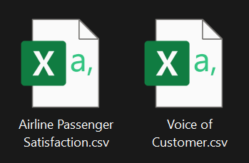
Datasets Provided
You are provided with two supporting datasets inside a zip file named ‘SMU DSA Society x Maersk Case Competition 2023 Datasets.zip’:
‘Airline Passenger Satisfaction.csv’ – This dataset documents the ratings of 129,880 unique airline passengers of a fictional airline. Ratings are categorized into different aspects of the airline’s service and an overall satisfaction score that indicates overall passenger satisfaction.
‘Voice of Customer.csv’ – This dataset extracts the verbatim feedback of the lowest scoring airline passengers (i.e., passengers with a satisfaction score of 0 – 4). There are 14,933 unique passengers with a satisfaction score of 0 – 4.
For more detailed information about each column of the datasets, refer to the Data Dictionary segment at the end of this slide deck. You are also free to do additional research on Maersk and the shipping/airfreight industry to supplement your model. However, the two above-mentioned datasets should form the basis of your findings.

Slide 12

Data Dictionary

Slide 13
Data Dictionary
Column | Interpretation
Gender | Passenger gender
Customer type | Customer loyalty
Age | Actual age of passengers
Type of travel | Purpose of the passenger flight
Class | Travel class in the plane of passengers
Flight distance | Distance of the journey
Inflight wifi service | Satisfaction level of the inflight Wi-Fi service; 0 not applicable, 1-5 where 5 is most satisfied
Departure/Arrival time convenient | Satisfaction level of Departure/Arrival time convenient
Ease of online booking | Satisfaction level of online booking
Gate location | Satisfaction level of gate location
Food and drink | Satisfaction level of food and drink
Online boarding | Satisfaction level of online boarding
Seat comfort | Satisfaction level of seat comfort

Slide 14
Data Dictionary
Column | Interpretation
Inflight entertainment | Satisfaction level of inflight entertainment
On-board service | Satisfaction level of on-board service
Leg room service | Satisfaction level of leg room service
Baggage handling | Satisfaction level of baggage handling
Check-in service | Satisfaction level of check-in service
Inflight service | Satisfaction level of inflight service
Cleanliness | Satisfaction level of cleanliness
Departure delay in minutes | Minutes delayed when departure
Arrival delay in minutes | Minutes delayed when arrival
Satisfaction | Airline satisfaction level (satisfied, neutral or dissatisfied)
Satisfaction score | Score of 0-10 where 0 - 6 is a highly dissatisfied customer, 7 – 8 a neutral customer and 9-10 a highly satisfied customer
Voice of Customer | Found in ‘Voice of Customer.csv’ dataset. It contains verbatim feedback of the lowest scoring passengers (i.e., passengers with a satisfaction score of 0 – 4). Passengers with no verbal feedback are indicated as ‘NIL’.

Slide 15
Good Luck!

